Slide 1
Status of ICT and Internet Connectivity
Prepared by: Dave Borja

Slide 2
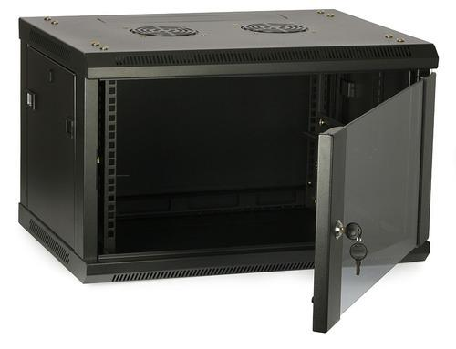

Calabanga
Overview of Campus ICT Infrastructure
L.H.S
Fisheries
Library
Science
Education
I.C.T
CHDC
Multi Media
2nd flr
G. flr
CoE Faculty
Fiber optic cable
Fiber optic cable
Fiber optic cable
CoED
Guard House
Multi Purpose
Fiber optic Redundant
Cat 6A Backbone
Fiber optic cable
R.O.C.O
Cat 6A Access point
Fiber optic cable
Access point
Data Cabinet
Supply
Social Hall
B.A.C
Fiber optic cable
Canteen
Trade
Hostel
Admin
CIT computer
Automotive

Slide 3
Calabanga
L.H.S
Fisheries
Library
Science
Education
I.C.T
CHDC
Multi Media
2nd flr
G. flr
Fiber optic cable
CoE Faculty
Fiber optic cable
Fiber optic cable
CoED
Guard House
Multi Purpose
Fiber optic Redundant
Cat 6A Backbone
Fiber optic cable
Fiber optic cable
R.O.C.O
Cat 6A Access point
Access point
Data Cabinet
Supply
Social Hall
B.A.C
Fiber optic cable
Canteen
Trade
Hostel
Admin
CIT computer
Automotive

Slide 4
Current Internet Connectivity
ISP: PLDT
Current bandwidth: 80Mbps /100Mbps]
Connection type: Fiber, leased line.
Monthly cost:
Recent upgrades or changes in ISP

Slide 5
Recent Network Performance
Uptime: [Percentage of time network was online]
Downtime incidents: [List any major outages or slowdowns]
Average speeds and latency: [Insert stats if available]
Network load statistics (peak usage times, heavy bandwidth users)

Slide 6
Current Challenges and Issues
Areas with poor Wi-Fi connectivity
Slow internet speeds during peak hours
Bams
  Biometric Scanning Errors
  Data Sync Problems
  System Downtime
Aging equipment in need of upgrades
Limited IT staff to handle network issues

Slide 7
Plans for Improvement
Upgrading hardware: New routers, switches, etc.
Increasing bandwidth from ISP or add new ISP
Expanding Wi-Fi coverage to remote areas of the campus
Hiring additional IT personnel
Regular network maintenance schedule

Slide 8
Recommendations for the Future
Partner with a new ISP for better service
Invest in ICT training for staff and faculty
Consider creating a dedicated budget for continuous ICT improvements
Encourage students and staff to report connectivity issues

Slide 9
Thank U

